Slide 1

Sailor
Submitted By :
Name: Samiu Esika Upoma ID:2020-1-60-082
Name: Israfil Arman ID:2020-1-60-086
Name: Zarin Tasnim Hassan ID:2020-1-60-169
Name: Fariha Mosharof ID:2020-1-60-171
Name: Zarin Tasnim Nuzhat ID:2020-1-60-211
Name: Md Habibuzzaman ID:2020-1-60-212
Name: Tanjilul Haq ID:2020-1-60-214
Name:Yusuf Salehin ID:2020-2-60-126
Submitted to :
Mashruha Zabeen
Senior Lecturer Department of Business Administration,
East West University

Slide 2
Executive summary
Main goal of the report is to know about the marketing strategy of “Sailor” .
Sailor is one of the Epyllion’s SBU.
With the motto “Human Spirit”, Epyllion Group started its journey in 1994 with a readymade garment’s unit in Dhaka.
We gathered information from Epyllion group’s Merchandiser Habibur Rahaman.

Slide 3

Introduction →Fariha Mosharof
Organizational Profile → Zarin Tasnim Hassan
Marketing Strategy → Israfil Arman
Product and Price → Yusuf Salehin
Distribution and Promotional mix → Zarin Tasnim Nuzhat
SWOT Analysis → Tanjilul Haq
Recommendation and Conclusion → MD. Habibuzzaman

Slide 4


Introduction and overview
Started journey as RMG in 1994. Reazuddin Al Mamoon is the CEO.
Established themselves as a leading garment manufacturer for a number of well-known brands in Europe, the United States and Australia.
The central theme is to fill the world with their unique abilities and turn the lives of ordinary citizens into local talents.
• Has both Foreign and Local retailer.

Slide 5
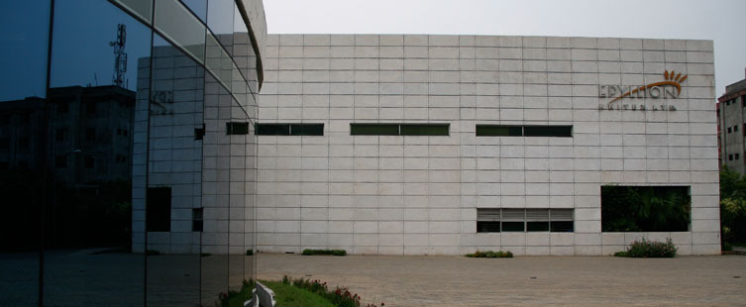
Introduction and overview
The Group is known as an entity whose main driven force is it’s human resources.
Overall management of the group is segregated into Executive Board Members & Management Committee (MANCOM) includes of 7 top executives.
Follow some Code of Ethics to conduct their business with honesty and integrity.

Slide 6

Organizational Profile:
History :
In 1994 Epyllion established itself as a readymade garments manufacturer.
Starting workforce was 200.
Units are located at Mirpur , Gazipur and Narayanganj.
Major exporting countries are the USA, Africa , Europe etc.
Started with 2 sewing lines.
Today, Epyllion group is capable of producing 92,000 pieces of readymade garments in a day.

Slide 7


Vision:
Epyllion became the lifestyle of its personnel , suppliers and buyers as well.Our vision is to become a window through which all our interacting parties can see and feel their prospect and dream about their success. Epyllion will become a lifestyle towards its employees, suppliers, buyers and above all shall become a role model of a green corporate house which will be regarded as an icon brand in the country.
Mission:
Epyllion will be known as an entity whose main driven force is its human resources. With such a motivated, high skilled and professional workforce, Epyllion has started marching towards its glory of success which is not profit but to enjoy the joy of life.

Slide 8
SBUs :
Garments Divisions-
Dekko Knitwears Limited
Epyllion Knitwears Limited
Dazzling Dresses Limited

Slide 9
Backward Linkage-
Textile unit
Epyllion Knitex Limited [EKL]
Epyllion Fabrics Limited [EFL]
Testing Laboratory
Epyllion Testing Lab Limited [ETLL]
Washing Unit
Epyllion Washing Unit [EWL]
Real Estate-
Nina Holdings Limited [NHL]
Food & Beverage Unit-
Epyllion Food & Beverage Limited [EFBL]
Retail Brand -Sailor :
With the theme “Sailing Life” Sailor launched in 2015. Now it’s a famous clothing brand. Sailor is a sister concern brand of Epyllion group.

Slide 10
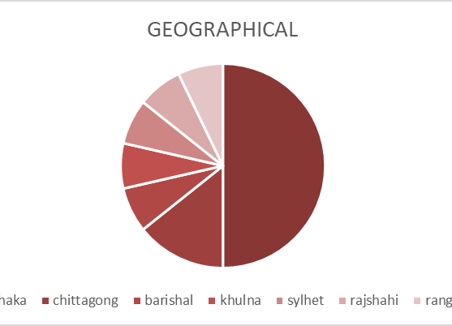
Marketing Strategy Segmentation:
Geographic :

Slide 11
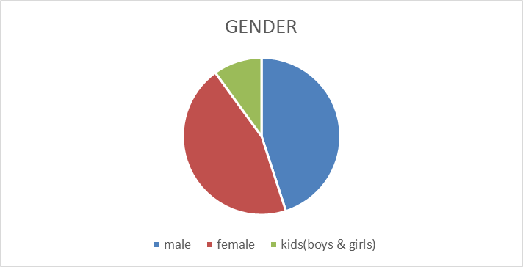
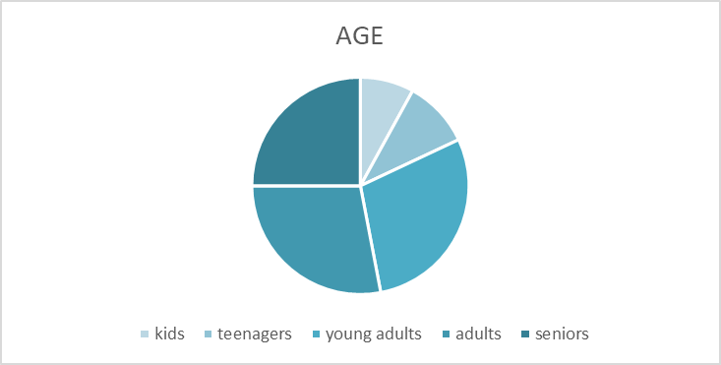
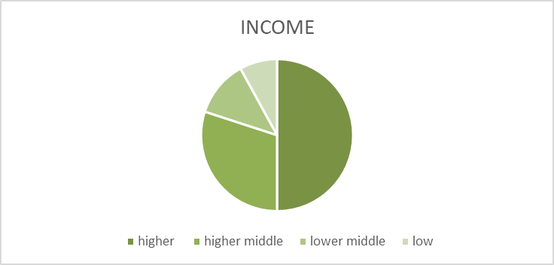
Demographic
Gender
Age
Income

Slide 12
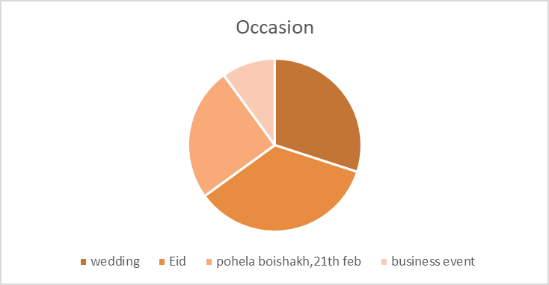
Behavioral
Occasion:

Slide 13


Targeting:
Differentiated or segmented marketing strategy is applicable for sailor. This brand targets several different market segments of the customers. They must have separate offers for each segment.
Positioning :
Sailor’s value proposition is “The same for less”
Positioning statement
“For fashion and comfort conscious people Our brand Sailor is an eminent lifestyle brand that delivers quality products at affordable price.”

Slide 14
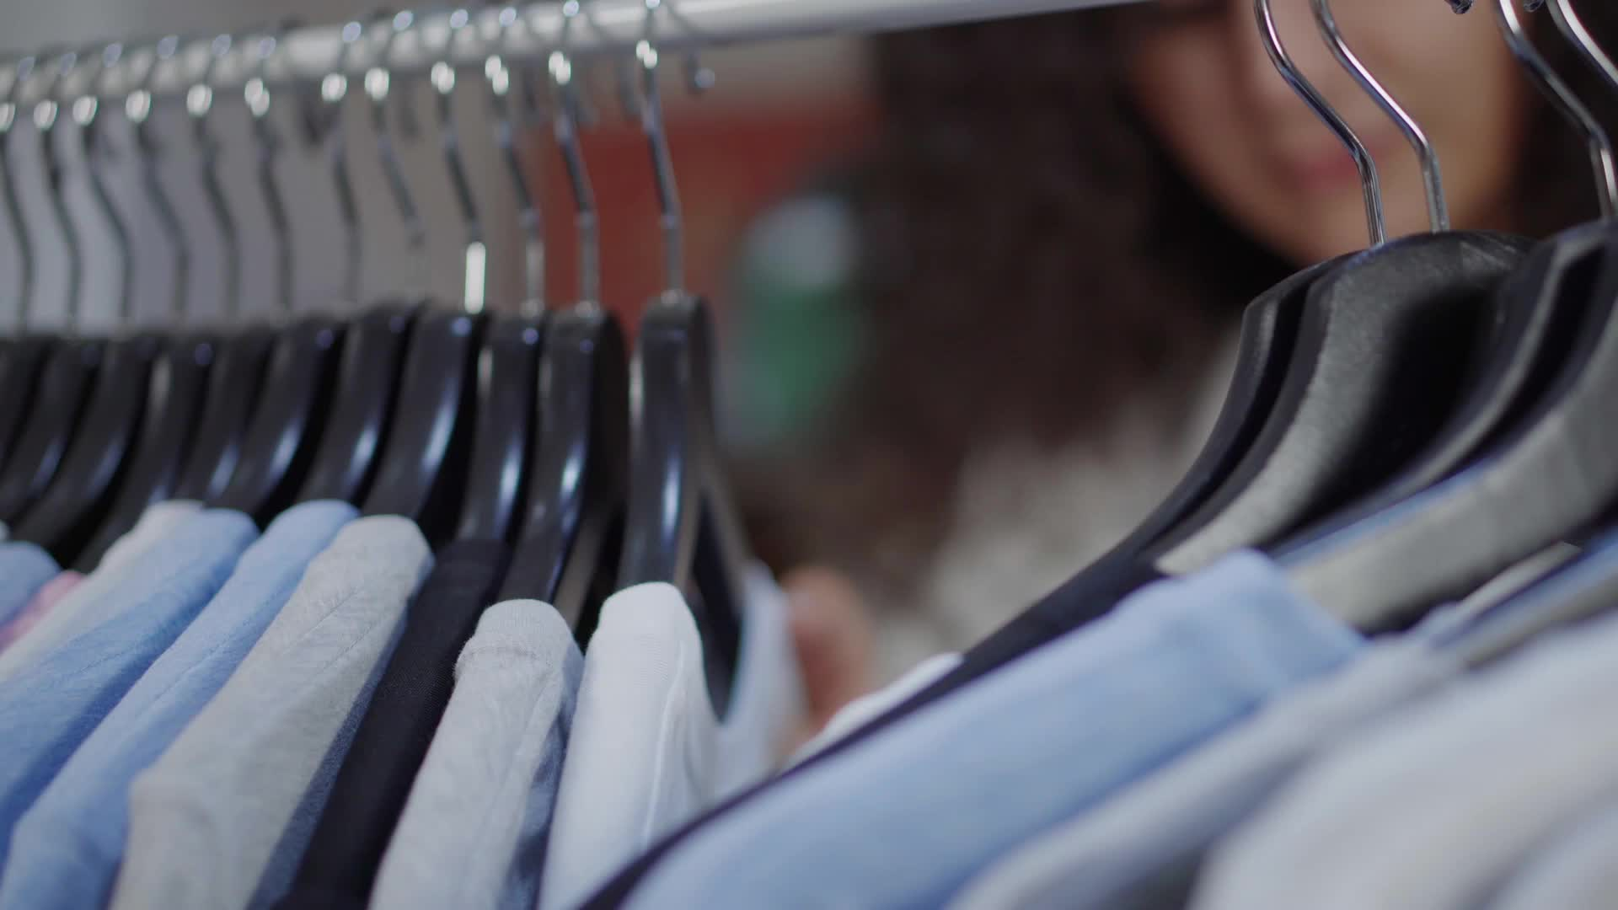
Differentiation
Product:
Sailor don’t sell Sharee whereas its competitors sell Sharee. On the other hand, sailor sells new-born baby dress, but its major competitors don’t.
Price:
Sailor is selling at a reasonable price whereas its competitor is selling at a higher price.

Slide 15
Product Product line :
# Men's casual and formal # MENS BOTTOM
# MENS ETHNIC #Women’s KURTI
#Womens SALWAR SUIT #Womens TOP
#Womens BOTTOM #Accessories for men and women
#Footwear for men and women #WINTER WEAR for men and women
# KIDS OUTFIT

Slide 16
Product strengthen :
Product Quality :
Weakness:
Best quality outfit at reasonable price
No compromise with quality
High quality imported products
standard design
Using best fabrics
New designing outfits
Taking some raw materials from local place

Slide 17
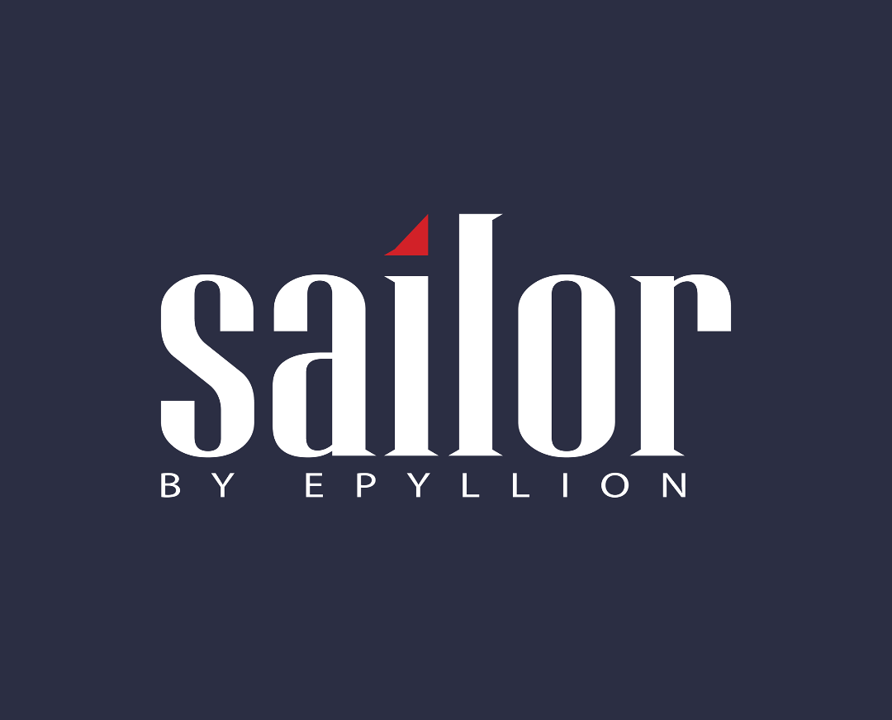
Logo :
Brand Name :
Slogan :
Sailor
Sail the life.

Slide 18
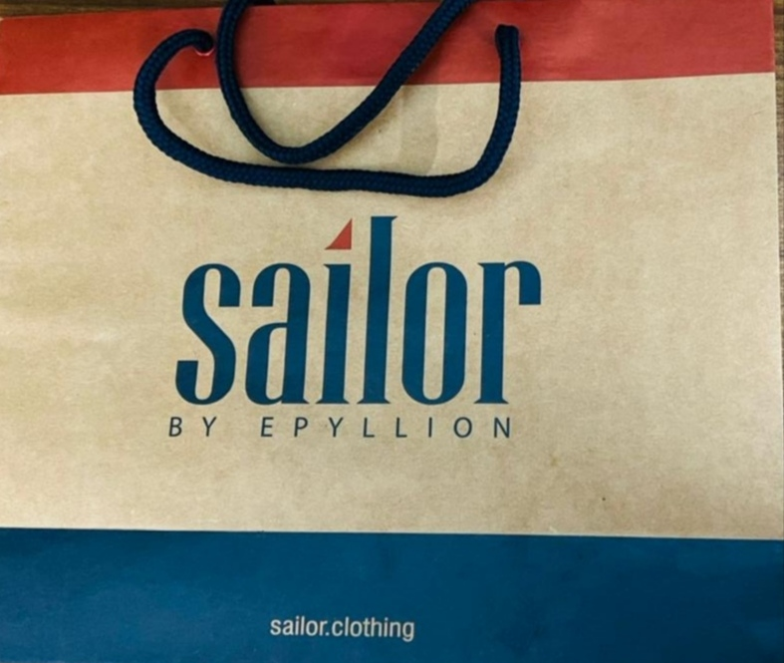
Packaging :
Pricing :
Applying value-based pricing
Good value pricing - products for middle class people at medium price level.
Value-Added Pricing – Premium quality products for higher class people.
Updating Price in Monopolistic market as there are too many same types of brand.
focus on competition-based pricing .

Slide 19
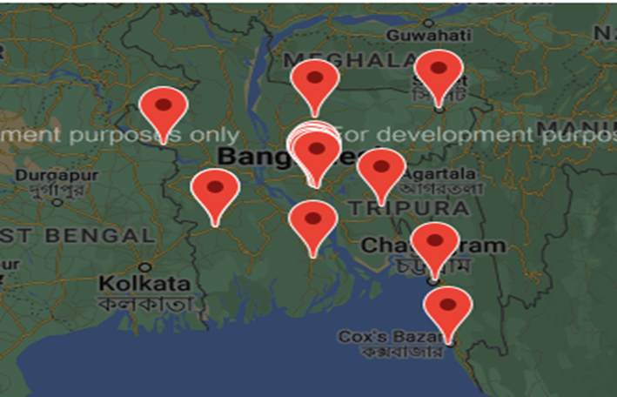
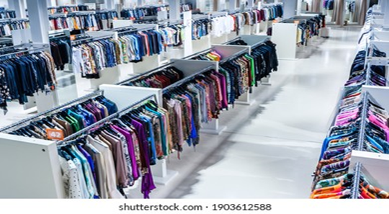
Marketing Mix Distribution
Geographical Coverage: Sailor, a brand whose distribution is all over Bangladesh. Their distribution is division based.
Distribution Channels and Partners: Sailors, Clothing companies have their own warehouses from where supplies are delivered to all Sailor outlets through their own transport system.

Slide 20
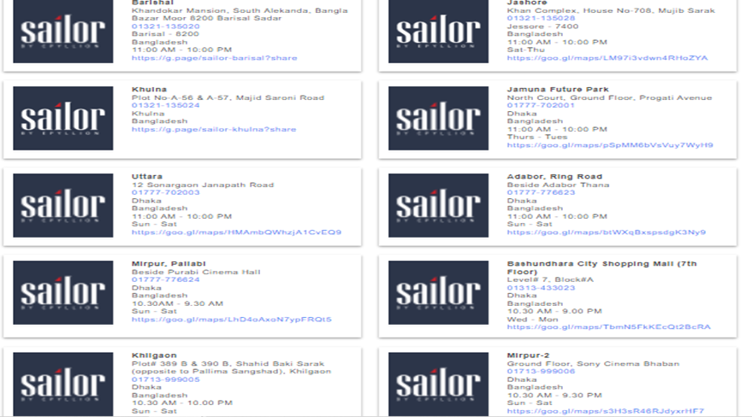
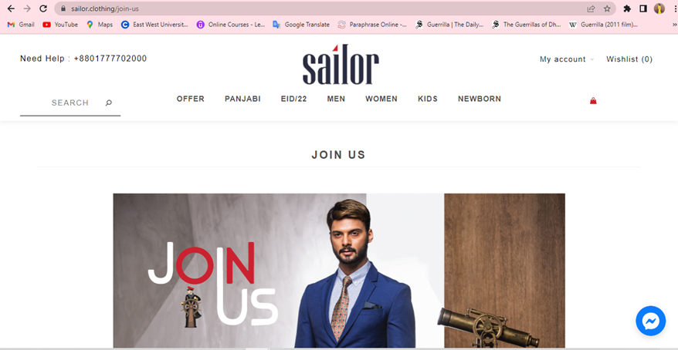
Marketing Mix Distribution
Physical Distribution and Logistics: Sailor has many outlets for physical distribution. Consumers can go there and shop as per their choice.
Electronic Distribution: Sailor has own official website. Through that site, the public can easily purchase any kind of product. Consumers can reach them by social media also. Customers contact with them though Messenger, WhatsApp etc.

Slide 21
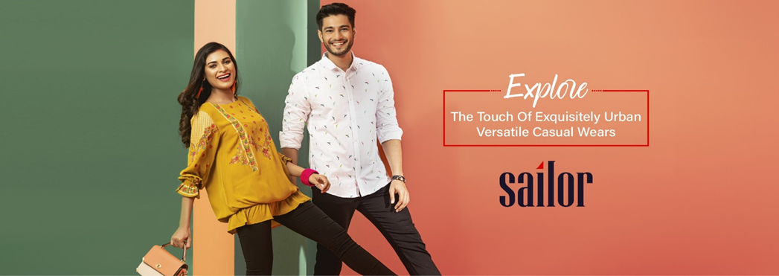
Marketing Mix Promotional Mix
Advertising: The Sailor Clothing brand promotes their products through advertising. They do advertising through billboards, online, digital media, social media etc.

Slide 22
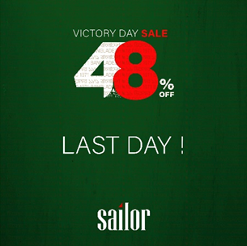
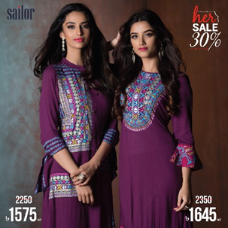
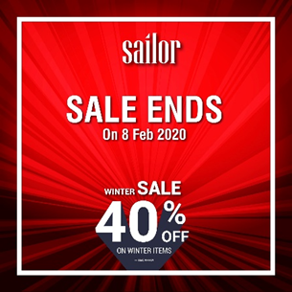
Marketing Mix Promotional Mix
Sales promotion: There is seen offering occasional or seasonal offers or discounts in SAILOR. They sometimes give discounts up to 30% or 70% on selective products and sometimes give discounts for cardholders or paying with BKASH OR NAGAD. Those who are employees of Epyllion get a 30% discount.

Slide 23
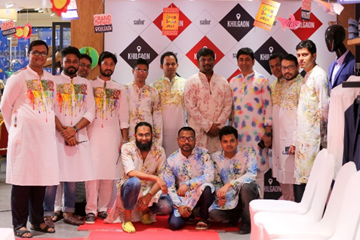
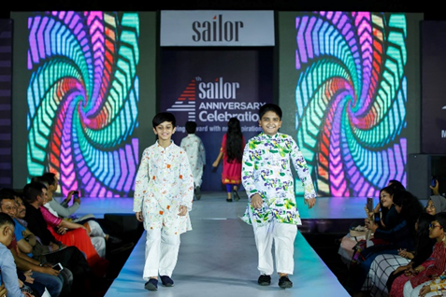
Marketing Mix Promotional Mix
Publicity and public relation: Sailor sponsors various events to build up good public relations.

Slide 24
Marketing Mix Promotional Mix
Electronic Promotion: We can see Sailor’s billboard beside the most common streets. Those who purchase products for once from Sailor, get a membership. Sailor inform update every single member through message.
Word of Mouth: Since Sailor's products are very good and quality, its reviews are also very good. Its customers always have a good reputation for it.

Slide 25
SWOT Analysis for Sailor:
1.Strength:
Unique and standard design.
Individual designer for different category.
Outlets in every division.
2.Weakness:
Buys raw materials from others.
Manufactures some products from China.

Slide 26
3.Opportunity:
Different festivals and occasions.
Sells some Accessories.
Upcoming days planning to open outlets in foreign
4.Threads:
Price war with competitors.
Pandemics.
Accessories manufacturing cost.

Slide 27
Recommendation
Introduce club marketing program
Add Saree as their new product
Establish an outlet in Mymensingh
Produce their own raw materials
Bring the machineries and manufacture products in Bangladesh

Slide 28
Conclusion
Keep up with their competitors and keep producing good quality products.
Be creative with new products and services.
Look for a chance of improvement of the existing products and services.

Slide 29

Thank YOU

